Slide 1
A Causal Inference Approach to Predict Sepsis in Patients Using Q-Learning
A Thesis Proposal by: Noah Dunn

Slide 2
Just a Few Notes Before We Get Started
I have prepared stopping blocks for questions as we go through the material
You are free and welcome to stop and ask questions at any point
If you need me to go back to a previous slide, feel free to ask and I will gladly oblige

Slide 3
Today’s
Outline
Introduction
Motivation
Contributions
Background and Related Work
Sepsis
Q-Learning
Causal Inference
Related Work
Research Overview
Proposed Methodology
Stopping Criteria
Evaluation Methodology & Metrics
Dissemination of Results
Timeline of Research
Conclusion
Future Work

Slide 4
Today’s
Outline
Introduction
Motivation
Contributions
Background and Related Work
Sepsis
Q-Learning
Causal Inference
Related Work
Research Overview
Proposed Methodology
Stopping Criteria
Evaluation Methodology & Metrics
Dissemination of Results
Timeline of Research
Conclusion
Future Work

Slide 5
Introduction
It’s always good to have a reason and a why

Slide 6
Personal Motivation
Steven Yu and I began this project with Dr. Gani in the fall of last year
I intend to pick up where we left off and conduct a formal research experiment
I want to gain as much knowledge in the field of CS to do my job(s) to the best of my ability
I find medical solutions to be of personal interest

Slide 7
Motivations
The Big Data age combined with the era of computational statistics makes coming up computer-related solutions to problems more available than ever
Testing complex algorithms and large batches of information can be done in mass with modern processors and programming languages

Slide 8
Motivations (cont.)
Hospitals and ICUs are overcrowded
Time not spent working directly with a patient in serious medical emergencies can lead to fatal consequences
Computer-assisted diagnosis is offering one solution to the issue
Doctors having the most information yields the greatest chance of taking care of a patient

Slide 9
Academic Contributions
This thesis will provide 2 contributions to the existing body of research
Provide a model that uses Q-learning techniques and existing patient data to predict Sepsis
Provide an optimization for that model using Causal Inference techniques

Slide 10
In Short
The Goal is to explore previous attempts to diagnose Sepsis, and produce a model that attempts to provide some degree of simplification or improvement towards those previous attempts
Accuracy and Simplicity of the model
These ideas will be discussed later in the proposed research methodology

Slide 11
Any Questions?
Personal Motivation
Motivation
Academic Contributions

Slide 12
Today’s
Outline
Introduction
Motivation
Contributions
Background and Related Work
Sepsis
Q-Learning
Causal Inference
Related Work
Research Overview
Proposed Methodology
Stopping Criteria
Evaluation Methodology & Metrics
Dissemination of Results
Timeline of Research
Conclusion
Future Work

Slide 13
Sepsis
The medical condition that started this entire research exploration.

Slide 14
Defining Sepsis
This was, and still is argued over today
A massive conference of physicians met to hash this out and dubbed themselves “Sepsis-3” (Because it was the third time this had been done in history)
The Sepsis-3 definition, which is widely used for computing purposes, is as follows:

Slide 15
Life-threatening organ dysfunction caused by a dysregulated host response to infection.

Slide 16
In Layman’s Terms
Sepsis is the body’s EXTREME response to an ordinary infection that is already plaguing the body
An infection somewhere already in a person’s body triggers a chain reaction throughout the body.

Slide 17

48.9 Million Cases
11.0 Million Deaths
Ranked in Top 10 Cases of Death Worldwide
Reported in 2017
Reported in 2017

Slide 18
Risk Groups
Current/Former HIV/AIDS or Cancer Patients
Young Babies ( < 3 Months Old)
The Elderly
People who have recently suffered a major injury
People with diabetes

Slide 19
Sepsis is Hard to Diagnose
The signs and symptoms leading up to a diagnosis are ambiguous
The various small organisms that cause disease to their hosts (pathogens) often reflect different symptoms
Sepsis affects the ability of a person to think coherently. A patient often doesn’t know what’s going on to the point of being deranged

Slide 20
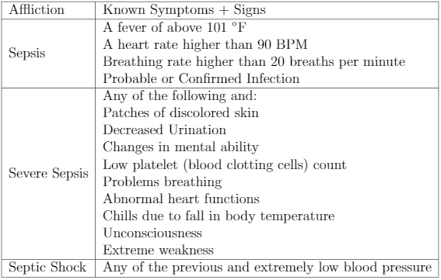

Slide 21
How do physicians diagnose Sepsis if it is so hard to do?

Slide 22
Two Modern Approaches
SOFA Score
Developed in 1994
6 Different Tests (One for each organ system)
Scale is 0-4 for each test
The slower and more thorough approach
quickSOFA (qSOFA) Score
Developed in 2016
1 Single Test
Scale is 0-3
The quicker and simpler approach

Slide 23
SOFA and qSOFA Scores
SOFA Score
Tests performance in
Respiratory
Coagulatory
Liver
Cardiovascular
Renal
Neurological
Systems
qSOFA Score is based on
Patient’s Systolic Blood Pressure (lower than 100 mmHg is bad)
Patient’s Respiratory Rate (more than 22 breaths a minute is bad)
Patient having an altered mental state (Scoring more than 15 points on the Glasgow Coma scale is bad)

Slide 24
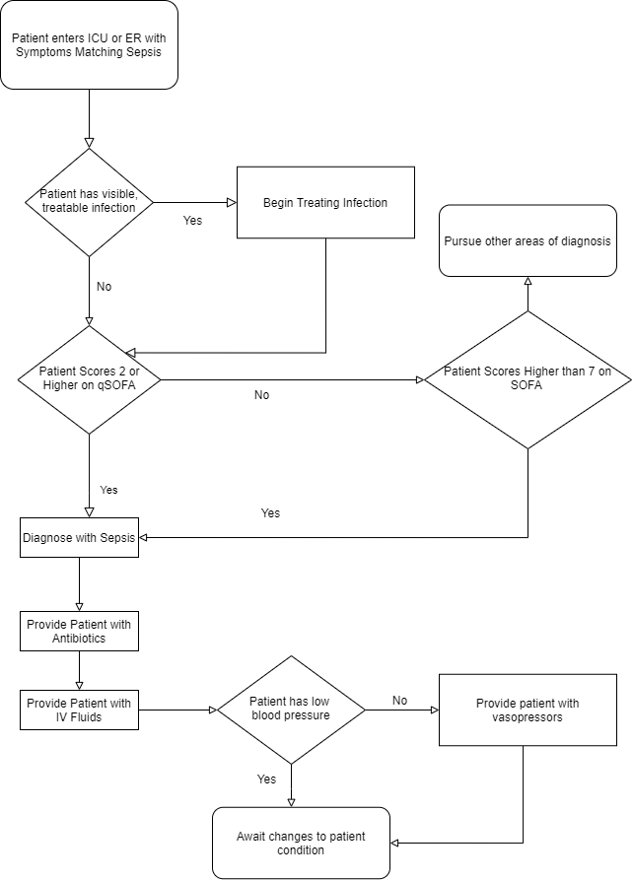
A Flowchart of the full Sepsis diagnosis + treatment process

Slide 25
Speed is the Key
Treatment within 6 hours of Sepsis recognition is ideal
Each hour of delay between suspected diagnosis and treatment decreases survival rate by 7.6%
Only 50% of patients with Septic Shock (the most deadly form of Sepsis) receive therapy treatment within 6 hours.

Slide 26
Any Questions?
Sepsis
Risk
SOFA vs pSOFA
Need for Speed

Slide 27

Q-Learning
Machine Learning for those who never look back.

Slide 28
Let’s Avoid Getting Ahead Of Ourselves
Q-Learning is a form of Machine Learning
Without understanding the basics of Machine Learning, Q-Learning will make little sense
So, what is Machine Learning?

Slide 29
The ability to make computers modify or adapt their actions so that their actions get more accurate. Accuracy is defined as more correct answers than incorrect answers.

Slide 30
There are Four Types of ML Algorithms
Supervised
Provided data with only correct answers (labels)
Builds a model that will give all correct correct answers to the initial data
Unsupervised
Provided data with no answers (labels)
Builds a model based upon similarities in input data
Evolutionary
Determines a metric for “fitness” of models (how good they are)
Adapts to models with higher fitness

Slide 31
Q-Learning Falls Under the 4th Category
Reinforcement
Provided information when the model comes up with the incorrect response, but not why the response is incorrect.
The Model tries multiple approaches until it gets the approach correct

Slide 32
Okay, but what does it actually do?
The Q-Learning algorithm optimizes individual qualities (that’s what the Q stands for) of the model.
A quality can be as simple as a factor in a model (like a patient’s blood type) and the optimization is how much the model believes that factor impacts the outcome
Recall: Our final output will be a model that we want to make more good decisions than bad ones.

Slide 33
No Turning Back
Q-Learning is Off-Policy, once it makes a decision it never goes back to consult previous decisions.
It will Iterate as many times as it needs until it is done
We can use Q-Learning to provide “best” solutions to several kinds of models, including Markov Decision Processes (MDPs)

Slide 34
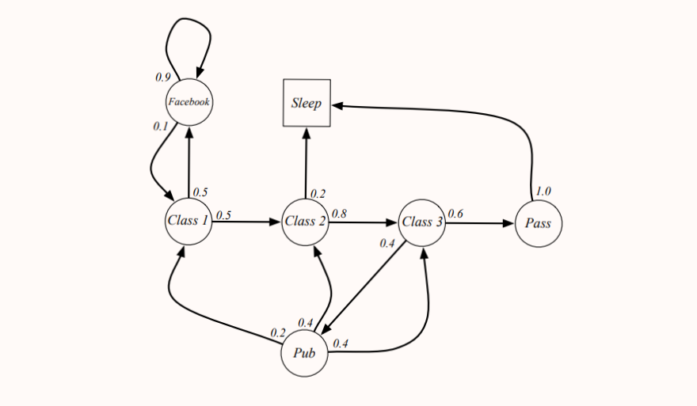
Example: A Markov Decision Process
4. A description of each action’s effects in each state (a decimal in this case)
1. A set of possible world states
3. A real valued reward function (not shown)
2. A set of possible actions

Slide 35
In short, we have places we are, actions we can take to get to other places, and rewards or consequences of taking those choices

Slide 36
Why Use MDPs?
They provide a way to model complex decisions
All decisions must be independent of decisions made in the past (sound familiar?)
The “real valued reward function” can be generated by Q-Learning’s output
They can be optimized by our final topic

Slide 37
Okay, I might be starting to understand this. But how does Q-Learning get us to that final model?

Slide 38
The Q-Learning Function
Qt+1 (st, at) = Qt (st, at) + α (rt+1 + γ max a Qt (st+1, a) − Qt (st, at))
MDP
Patient Vitals
Sepsis: Yes/No
Q-Learning

Slide 39
Causal Inference
Set initial edge weights
Penalize models that violate causal inference
MDP
Patient Vitals
Sepsis: Yes/No
Q-Learning

Slide 40
NOPE

Slide 41
Next Q-Value
Q-Value of best possible action given the current state
Qt+1 (st, at) = Qt (st, at) + α (rt+1 + γ max a Qt (st+1, a) − Qt (st, at))
Current Q-Value

Slide 42
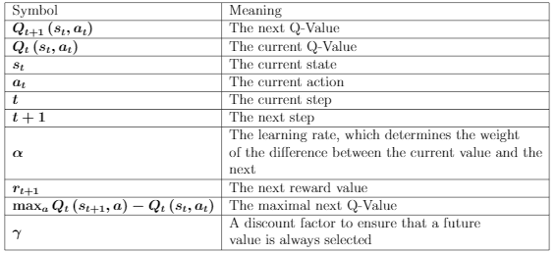
Qt+1 (st, at) = Qt (st, at) + α (rt+1 + γ max a Qt (st+1, a) − Qt (st, at))

Slide 43
That function will produce the Q-Equation
Given any state, the Q-Equation will produce the best action at that state
For in example, in Sepsis diagnosis. If we are at a state where a patient is demonstrating higher blood pressure, lower brain activity, and a high respiratory rate(qSOFA), the model may determine the best action as Sepsis diagnosis

Slide 44
Any Questions?
Q-Learning
Markov Decision Processes
Our Goal
Q-Learning Function
Q-Equation

Slide 45
Causal Inference
Why?

Slide 46
Statistical Inference
Main method of determining significant differences between data
Builds models with predictors (factors) that when given values produce an outcome
For Sepsis, we want a model that can diagnose when provided a patient’s vitals
Does not explain why predictors are related

Slide 47
Causal Inference: A New Approach
Prof. Judea Pearl received a Turing award for his work on this topic in 2012
Goal is to represent causal claims in a field that does not often consider them
Allows the creation of Structural Causal Models

Slide 48

A person’s wealth
How much a person goes out to eat

Slide 50
There is a strong, positive correlation between a person’s wealth and how much they go out to eat.

Slide 52
Is This Necessarily Wrong?
No. Not at all.
However, we can do better.

Slide 53
A person’s age

Slide 55

Baby’s First SCM
Causes
Causes

Slide 56
Baby’s First SCM
Causes
Causes

Slide 57
Defining the Environment
The statistician decides what is exogenous to the model (outside the scope) or endogenous to the model(inside the scope)
They then find as many causal relationships as possible

Slide 58
Available Structures in SCMs
Chains
Forks
Colliders
We can combine these as desired

Slide 59
An Example Chain

Slide 60
An Example Fork

Slide 61
An Example Collider

Slide 62
Intervention
At any point in the diagram. We can fix a constant value. This is called an “intervention”
This value may be arbitrarily chosen for testing, but in more useful cases, is likely obtained from some other study.
Possible across many different kinds of modeling

Slide 63
Intervention
0.26

Slide 64
What’s the point?
We see what is really happening better
We have a scientific approach to making causal claims
Our models show the relationships at a certain scope

Slide 65
More Practically
SCM techniques can be used to build better MDP
Better MDP models result in better Q-Learning Solutions
Better Q-Learning solutions yield more accurate diagnoses.

Slide 66
Any Questions?
Causal Inference
Structural Causal Models (SCM)
Forks, Chains, Colliders
Intervention
The Benefits

Slide 67
Today’s
Outline
Introduction
Motivation
Contributions
Background and Related Work
Sepsis
Q-Learning
Causal Inference
Related Work
Research Overview
Proposed Methodology
Stopping Criteria
Evaluation Methodology & Metrics
Dissemination of Results
Timeline of Research
Conclusion
Future Work

Slide 68
Related Work
Understanding the path that has lead to the current point

Slide 69
Using Q-Learning For Sepsis Treatment + Diagnosis
Much of the existing research body focuses on the treatment of Sepsis, given a suspected Sepsis Diagnosis
If this proves more accurate to determining the endpoint for diagnosis, my research may direct the models towards this approach
At least 8 well-developed, peer-reviewed papers on the topic worth going through

Slide 70
PhysioNet Computing in Cardiology Challenge
Computing contest to build models capable of diagnosing Sepsis 6 hours prior to the time a real physician could
Early Diagnosis was rewarded, late and incorrect diagnosis were penalized
Winning Team used a ‘signature-based regression model’ which mixed supervised and unsupervised modeling techniques
Primary inspiration for this thesis

Slide 71
Komorowski et. al AI Clinician
Uses a Q-Learning implementation provided by MatLab’s public tooling offerings
Optimal Treatments are produced by the model when a patient data is provided as input
Goal here is treatment rather than diagnosis, including the provision of mostly vasopressors (raise blood pressure), antibiotics (treat infection), IV fluids (getting vitals stable)

Slide 72
Raghu et. al DDQN
Uses ‘Double Deep Q-Learning’ method paired with a ‘Dueling Q Network’
The ‘Double’ portion comes from the main network passing information to a second network to determine Q-values rather than by doing everything in the main network
The ‘Dueling’ portion comes from the addition of a second parameter called ‘advantage’ that determines how good a given choice was

Slide 73
Raghu et. al DDQN (cont.)
The resultant model adopted a policy that did not prescribe vasopressors unless the patient’s SOFA score was very high.
It performed very well for low-mid (0-5, 5-15) SOFA scoring patients, but suffered a high mortality rate for high-SOFA patients (>15)
They deemed this was likely due to a lack of data available in that range

Slide 74
Raghu et. al Optimization
Raghu et. al published another paper that added an additional technique the “Doubly Robust Off-policy Value Evaluation” provide the Q-Value for each State/Action\
They pitted the previous model (DDQN) against a new model (Sparse Autoencoder DDQN).
Note, a Sparse Autoencoder is a fancy way of saying we have more rather than less hidden information as input to the model

Slide 75
Raghu et. al Optimization (cont.)
The updated DDQN model was able to reduce patient mortality from Sepsis by up to 3.6% percent from the baseline mortality rate of 13.7%
The DDQN and autoencoder version both prescribe vasopressors like a real physician would, but the auto-encoder variant does better than a real physician in the context of prescribing IV fluids.

Slide 76
Peng et. al MOE(Mixture of Experts) Approach
This group mixes Raghu et. al’s DDQN approach with a Kernel Reinforcement Learning (KRL) approach
The KRL aspect groups nearby neighbor states together, and takes distributed actions based on those groupings
Researchers prioritize the following: Age, Elixhauser Medical Index, SOFA, FiO2, BUN, Glasgow Coma Scale, Albumin, Trajectory Length, Max Distance from Nearby States

Slide 77
Peng et. al MOE(Mixture of Experts) Approach (Cont.)
MOE was closest in decisions to the KRL approach
MOE benefitted from the dosage amounts prescribed from the DDQN half of the model, and the distributed approach of the KRL model
The researchers found that the MOE model outperforms the individual models and their clinician policy which maps the exact behavior of a real physician
Still Suffers from extreme responses to outliers

Slide 78
Petersen et. al Cytokine Study
Petersen et. al diverged from the traditional approaches, and focused on trying to use cytokine signaling to treat Sepsis
Cytokines are cells that signal if something is wrong in the human body
The model uses a stock version of Deep-Q learning to prioritize treating areas where Cytokines were active

Slide 79
Petersen et. al Cytokine Study (cont.)
Model obtained 0% mortality on the data set it was trained on.
Model obtained 0.8% mortality on 500 randomly created/selected patient parameterizations (fake patients) with baseline mortality values of between 1% and 99%

Slide 80
Petersen et. al Cytokine Study (cont.)
These figures may seem impossible at first, and that’s because they largely are
The model medicates cytokine areas for which no known drugs are capable of medicating.
In essence, the model performs magic on the areas of high impact to fix them.
The idea of analyzing cytokines is a fresh one, and not present in the other models

Slide 81
Tsoukalas et. al POMDP Model
Uses a POMDP (Partially Observable Markov Decision Process) to build the states and actions of a patient
Solves these models with an algorithm called Perseus
The Result is a tool that recommends treatment based on patient data

Slide 82
Tsoukalas et. al POMDP Model(cont.)
Results: When following the optimal policy recommended, 25.9% of patients transfer to a better state 90% of the time 33.7% of patients transfer to a worse state 90% of the time
Non-policy decisions performed as follows 12.9% of patients transfer to a better state 90% of the time 51.2% of patients transfer to a worse state 90% of the time
(+13.0% good performance, -17.5% bad performance)

Slide 83
Review of the Related Work
RESEARCH GROUP | MODEL TYPE
PhysioNet Winner | Signature-Based Regression Model Mix of Supervised + Unsupervised
Komorowski et. al AI Clinician | Stock Q-Learning from MatLab
Raghu et. al | Dueling Double Deep Q-Learning
Raghu et. al Optimization | DDQN and Sparse Autoencoder DDQN
Peng et. al | MOE (DDQN + KRL)
Petersen et. al | Stock Deep Q-Learning on Cytokines
Tsoukalas et. al | POMDP + Perseus Algorithm

Slide 84
Any Questions?
Related Work

Slide 85
Today’s
Outline
Introduction
Motivation
Contributions
Background and Related Work
Sepsis
Q-Learning
Causal Inference
Related Work
Research Overview
Proposed Methodology
Stopping Criteria
Evaluation Methodology & Metrics
Dissemination of Results
Timeline of Research
Conclusion
Future Work

Slide 86
Proposed Methodology
The method behind the madness

Slide 87
Research Roadmap
Gather and construct a full dataset to do testing on (from public data)
Optimize the MDPs + Models with Causal Inference Techniques
Data
Optimizing
Modeling
Build MDPs and test them with Q-Learning techniques

Slide 88
Data Source 1: PhysioNet Sepsis Data
Composed of two data sets: A and B
A contains information on 20,336 subjects
B contains information on 20,000 subjects
Data is publicly available
Offers information on a patient throughout the course of a day, including their Sepsis status

Slide 89
Data Source 1: PhysioNet Sepsis Data (cont.)
Gathered from 3 Hospitals
Over a timespan of around a decade
Data comes from three different EMR systems (Electronic Medical Record) from three different hospitals
The hospitals in question:
Beth Israel Deaconess Center (Boston, Massachusetts)
Emory University Hospital (Druid Hills, Georgia)
An Unidentified Hospital

Slide 90
Data Source 2: MIMIC-III
> 1 Decade of anonymized medical records
Publicly available, but requires certificate (That I have)
Data is very sporadic and is loaded with inconsistencies
Komorowski et. al have scripts to extract, cleanse, and specify Sepsis data from the database
Komorowski et. al was able to extract 17,083 ICU patients from 5 ICUs in their research using MIMIC-III

Slide 91
Data Cleaning
Komoroski et. al have a publicly available script that uses values provided by MIMIC-III’s support to only grab the patients that meet the Sepsis-III definition
The script also replaces values that are out of range, or non-existent with identifiers for all of a patient’s vitals

Slide 92
Data Cleaning (cont.)
Datasets A and B are fully cleaned, with a varying number of timestamps per patient, indicating at each time stamp (15 minutes apart) whether or not a patient has Sepsis or not
They are not complete, there is a large amount of missing data

Slide 93
Initial Q-Learning Combinations
TRAINING SET | VALIDATION SET
A or B | MIMIC-III
A and B | MIMIC-III
MIMIC-III | A or B
MIMIC-III | A and B

Slide 94
There is a Problem
The training set and testing set must have the same number of factors/labels in order to proceed with accuracy (pointed out to me by Dr. Giabbanelli)
They are not one to one
There are two solutions to this issue

Slide 95
Potential Solutions
Use one or the other, but not both (likely MIMIC-III, due to its ICU diversity)
Only include the data that exists in both area in the models

Slide 96
Which is Better?
There are tradeoffs to either
As Dr. Giabbanelli pointed out to me, merging the two data sets would open the door for Cross Validation, providing more data on both the models
This comes at the cost of having to manipulate one set of data into looking exactly like the other

Slide 97
Which is Better? (cont.)
For now, the experiment will be conducted on MIMIC-III alone, as the data cleansing scripts, Sepsis-III extraction, and as we are about to see MDP generation scripts already exist for this data set
Should additional data be required in the future, I am going to consult Dr. Giabbanelli on how best to prepare these kinds of models

Slide 98
Cross Validation
In order to test the quality of just the MIMIC-III data, Cross Validation techniques can be employed.
Cross Validation grabs a small subset of the existing data, and tests the current model against it for how well it performs

Slide 99
Hyperparameter Optimization
In the Q-Learning equation shown before, the discount factor and the rate of learning are what are called ‘Hyperparameters’, or values that are set prior to conducting the learning
Ex: Number of iterations, learning rate, discount factor, etc.

Slide 100
Hyperparameter Optimization (cont.)
There are a number of approaches for optimizing these values
Grid Evaluation: Provide a set list of all possible values and validate how they perform
Random Selection: Pick values purely at random and test
Q-Learning: Use a parallel Q-Learning algorithm to train for optimal hyperparameters

Slide 101
The Approach for this Research
My goal is to attempt a separate Q-Learning chain, as many of the related works have undergone a similar process to optimize their value functions
There are a number of research papers in various other fields attempting hyperparameter optimization using Q-Learning (including self-driving cars)

Slide 102
Any Questions?
The Potential Data Sources
Data Cleaning
The Issue in the Testing Combinations
The choice of MIMIC-III (for now)

Slide 103
Building the Initial MDPs
There are several ways to programmatically generate MDPs
The most basic method is to to randomly assign states and actions and then test
This research seeks to emulate the Komoroski process, and in practice, more effective models are built that reflect trends in the underlying data

Slide 104
Building the Initial MDPs
The Komorowski et. al scripts build MDPs using a Clustering technique called ‘k-means++’
In our context, K-Means++ fixes groups of patients based on criteria from time-series data
They have provided scripts which build 500 distinct MDPs from a provided data set.

Slide 105
Implementing Q-Learning
MatLab has a Q-Learning Toolbox available free to the public online
Much of the existing work (including the Komorowski et. al research) makes use of MatLab scripts
There is a Python option that offers the same functionality

Slide 106
What all is there at this point?
The input data set is created
MDPs are built from the data sets
Q-Learning is used to provide solutions to those data sets
Those solutions are models to predict Sepsis
There is some idea of which solutions are the best of the bunch

Slide 107
Improvement by Simplification
Model output can yield dozens of factors used to predict a diagnosis
In general, it is said in statistics that simpler models are better than complex models
Simple models are less susceptible to outlier bias, as well as conforming directly to a single data set

Slide 108
Improvement by Simplification (cont.)
Prior to talking with Dr. Giabbanelli, I did not know the concept of feature selection. I was only aware of manual selection from my Statistical Modeling course
Feature selection is an automated way to simplify models, keeping only the relevant factors that have a significant impact on the output

Slide 109
Improvement by Simplification (cont.)
An additional benefit feature selection offers is that it does not yield a drastic decrease in accuracy in order to simplify
This route is much better than my initial proposal to manually simplify.

Slide 110
Okay, but what about the Causal Inference we discussed earlier? Wasn’t that the new and unique part to this whole process?

Slide 111
Optimizing with Causal Inference
Causal Inference offers the researcher a means to manipulate the order of an MDP: the presence or absence of certain states of actions
Models that direct actions from one suspected cause to another are likely to yield more meaningful, and thus, more accurate models

Slide 112
Optimizing with Causal Inference(cont.)
In particular, medical insights that are already in existence offer some promising ways to orient states and actions
The usage of what is known about qSOFA and SOFA can direct MDPs to weight a collection of factors towards a diagnosis
Acknowledging common factors present in all the best MDPs in the initial test run could provide some indication of causal relationships

Slide 113
Optimizing with Causal Inference(cont.)
In addition, interventions in the form of specific values can be fixed on different factors to see if they produce better results than their data-driven counterparts
Similar to simplification, Causal Inference exchanges in the best models will go through several rounds until no better can be done with re-arrangement or fixing values

Slide 114
A qSOFA Example
Sepsis
Diagnosis
Systolic Blood Pressure
Respiratory Rate
Glasgow Coma Scale

Slide 115
Alternatively
Sepsis
Diagnosis
0.9
0.6
0.85

Slide 116
Research Roadmap
Gather and construct a full dataset to do testing on (from public data)
Optimize the MDPs + Models with Causal Inference Techniques
Data
Optimizing
Modeling
Build MDPs and test them with Q-Learning techniques

Slide 117
Any Questions?
Data Gathering
Building MDPs
Running Q-Learning
Optimization

Slide 118
Today’s
Outline
Introduction
Motivation
Contributions
Background and Related Work
Sepsis
Q-Learning
Causal Inference
Related Work
Research Overview
Proposed Methodology
Stopping Criteria
Evaluation Methodology & Metrics
Dissemination of Results
Timeline of Research
Conclusion
Future Work

Slide 119
The Endgame
When are we done and how did we do?

Slide 120
Stopping Criteria
Once all rounds of causal inference optimization have taken place, the best of all available models will be chosen, in tandem with the MDP it was built using.

Slide 121
Evaluation Methodology and Metrics
Recall -> True Positives / (True Positives + False Negatives)
Precision -> True Positives / (True Positives + False Positives)
F1 Score -> 2 * ((precision * recall) / (precision + recall))
ROC Curve -> Plots true positive rate on the y-axis, and false positive rate on the x-axis
CONFUSION MATRIX ->

Slide 122
Evaluation Methodology and Metrics(cont.)
The Komorowski et. al provides some metrics on treatment (rather than diagnosis), however, some of the models they provide can offer some insight on model behavior
Nemati et. al developed a model that could achieve 85% correct diagnosis rate on a set of ICU data, which offers at least some benchmark to shoot for

Slide 123
Dissemination Of Results
Some offerings of potential conferences for final submission by Dr. Rao:
ACM Transactions on Modeling and Computer Simulation (TOMACS)
Simulation: Transactions of the Society for Modeling and Simulation International
Frontiers In Artificial Intelligence

Slide 124
Dissemination Of Results(cont.)
All of these publications are simulation and modeling heavy
They accept papers whose domain matter is medical related
The journals published to these sources take a similar approach to my proposed methodology

Slide 125
Dissemination Of Results (cont.)
Some offerings of potential conferences for final submission by Dr. Giabbanelli
Journal of Medical Internet Research (JMIR)
BMC Medical Research Methodology
International Journal of Medical Informatics
BMC Medical Informatics and Decision Making
EPJ Data Science
ACM Transactions on Data Science

Slide 126
Dissemination Of Results(cont.)
All of this publications are very highly rated
These publications are very machine learning intensive

Slide 127
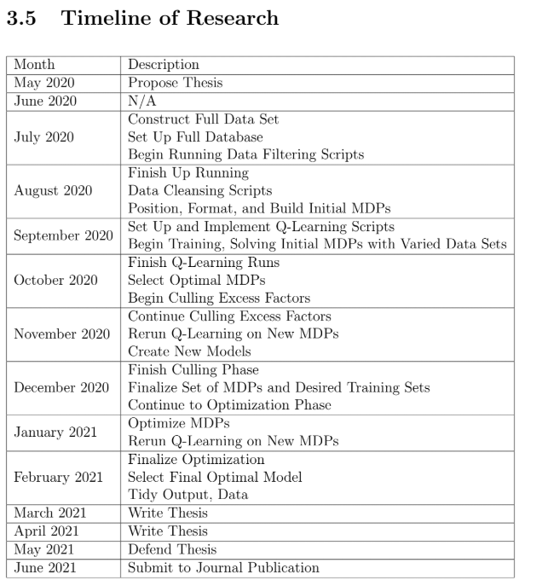

Slide 128
Any Questions?
Stopping Criteria
Eval. Methodology + Metrics
Dissemination of Results
Timeline

Slide 129
Today’s
Outline
Introduction
Motivation
Contributions
Background and Related Work
Sepsis
Q-Learning
Causal Inference
Related Work
Research Overview
Proposed Methodology
Stopping Criteria
Evaluation Methodology & Metrics
Dissemination of Results
Timeline of Research
Conclusion
Future Work

Slide 130
Final Thoughts
The end and the future

Slide 131
Conclusion
The end of the entire experiment will yield an optimal MDP, a Q-Learning solution to that MDP, and the optimization of that MDP -> Solution using Causal Inference techniques.
The result will yield an indicator of the feasibility of this approach for future diagnosis models
As an overarching result, the experiment will yield an understanding of the usage of Reinforcement-based Machine Learning for diagnosis related purposes

Slide 132
Future Work
This proposal is the launchpad for the full thesis and experiment
Hopefully, much of what has been presented today will make it into the final paper that concludes my Master’s studies.
It is my goal that the work I invest in this experiment will be used by further researchers to solve the Sepsis problem for good and save as many lives as possible

Slide 133
Giving Credit Where Credit is Due
This entire presentation’s theme was provided by SlidesCarnival under the Creative Common’s License.
Also several of these slides follow stylistic guidelines and examples provided by SlidesCarnival
Icons provided by FontAwesome also under CC

Slide 134
Thank You!

